Slide 1
Predicting Taxon and DNA Type From Codon and Amino Acid Frequencies

Slide 2
Background
DNA is organized into codons of three sequential base pairs
The 64 possible codons code for 20 amino acids
Many amino acids are produced by multiple codons
Prior research (Khomtchouk 2020) demonstrates that taxonomic group and DNA type can be predicted from codon frequencies
Analyzing codon frequencies is far less computationally intensive than analyzing entire gene sequences
Perhaps it’s also possible to use amino acid frequencies

Slide 3
Study Overview
Data used in prior study from CUTG database for reproducibility
Amino frequencies generated from codons using dictionary
Data scaled, outcome variables (DNAtype and kingdom) encoded
Three way train-validation-test split applied
Codon and amino frequencies used to predict DNAtype and kingdom using k-NN, Random Forest, XGBoost, MLP, and Naive Bayes models
SHAP analysis used for feature importance

Slide 4
Data Preprocessing
Data from 2020 study used; 13,028 observations, 69 variables
Source: https://archive.ics.uci.edu/ml/datasets/Codon+usage
Data put into pandas dataframe; type issues resolved
Column labels decoded for clarification
Sparse groups trimmed to improve model fit; 62 rows removed
One-hot encoding used for categorical response variables
Three-way train-validation-test split applied

Slide 5
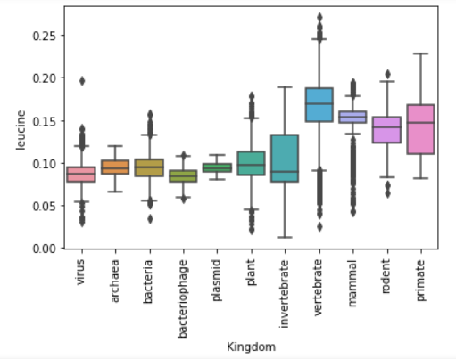
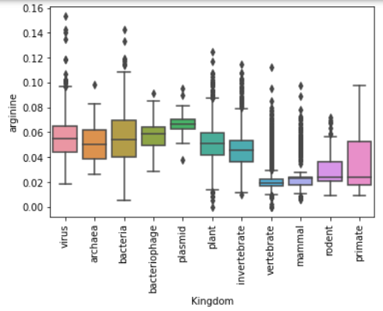
Exploratory Data Analysis
Data are moderately unbalanced
Boxplots illustrate relationships among taxonomic groups

Slide 6
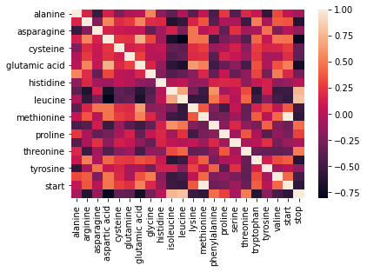
Exploratory Data Analysis 2
Scatterplots show some strong correlations between aminos
Needs further exploration

Slide 7
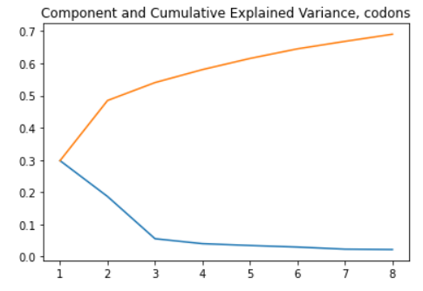
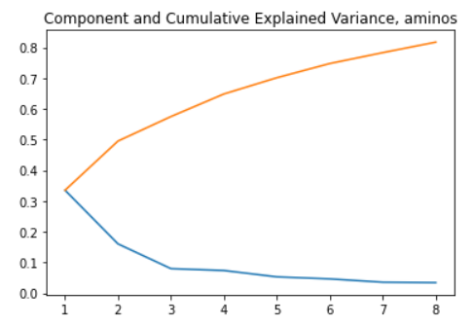
Principal Component Analysis
PCA displayed ‘elbow’ at 3 PC’s for both codons and aminos
Explained variation not sufficient for reliable model construction

Slide 8
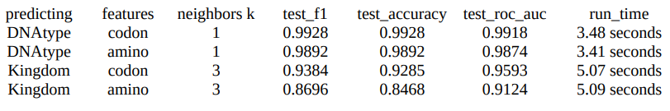
K-Nearest Neighbors
K-NN predicts categories by plurality of k closest observations
K optimized at 1 for predicting kingdom, 3 for DNAtype
Fast runtime; more effective at predicting DNAtype

Slide 9
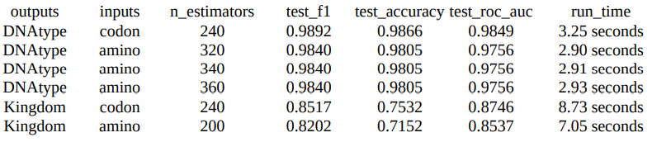
Random Forest
Ensemble of decision trees; hyperparameter # of trees
Optimization found marginal differences with respect to #
Three different tested values had identical highest test F1

Slide 10
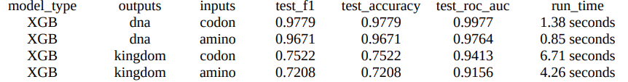
Extreme Gradient Boosting
Decision tree ensemble with gradient boosting
Large hyperparameter space
Models were built with default hyperparameters, then optimized

Slide 11
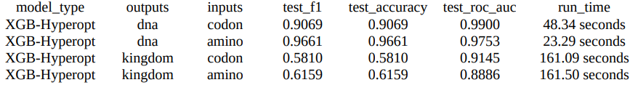
XGBoost with Hyperopt
XGBoost has many hyperparameters; hyperopt used to optimize
Search time increases with hyperparameter space
Model assessment metrics were worse than XGB defaults

Slide 12
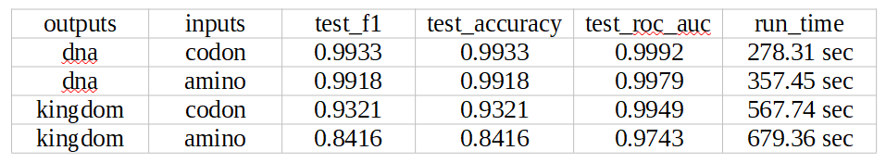
Multi-Layer Perceptron
Artficial neural network with hidden layers and nonlinear activation
Hyperopt used to optimize over hyperparameter space
Slowest ML method used but produced best results overall

Slide 13
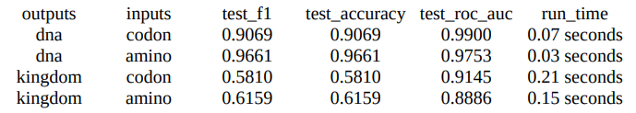
Naive Bayes
Simple and fast ML model; no hyperparameters
Assumption of independence among features is false
Produced uniformly worst results; predicting kingdom particularly

Slide 14
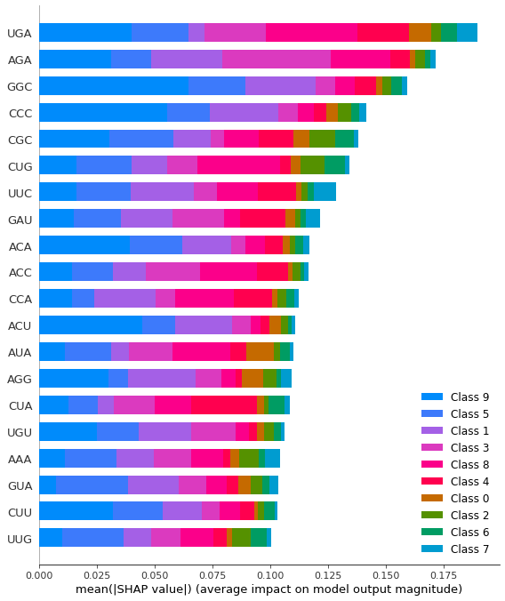
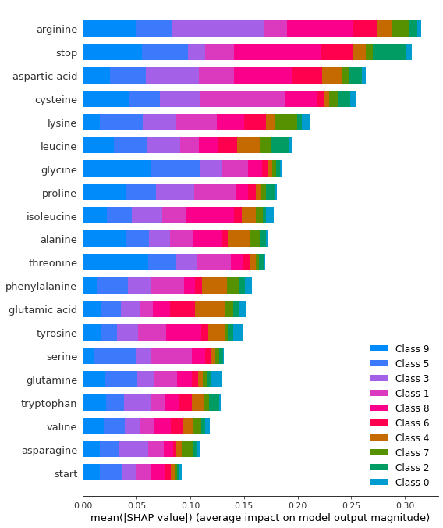
Feature Importance
Feature importance was computed for RF, XGB, and MLP models
Both SHAP values and built-in methods used
Results generally similar
Needs more systematic
evaluation and further
study

Slide 15
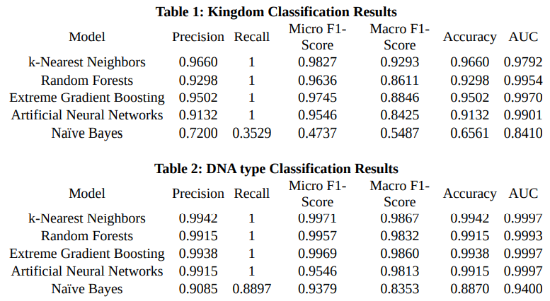
Results (Khomtchouk 2020)

Slide 16
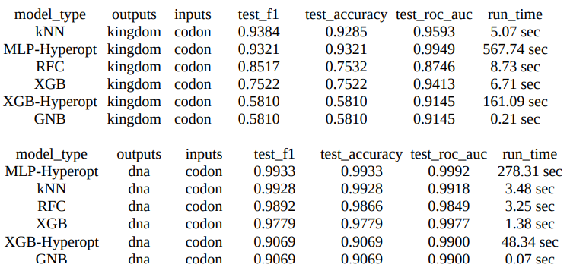
Study Results (codon)
Some similarity to 2020 study; MLP and k-NN best models

Slide 17
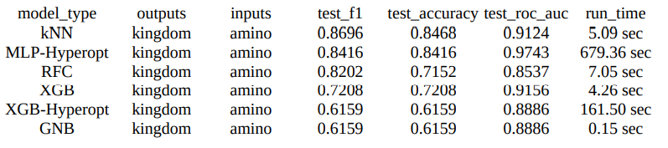
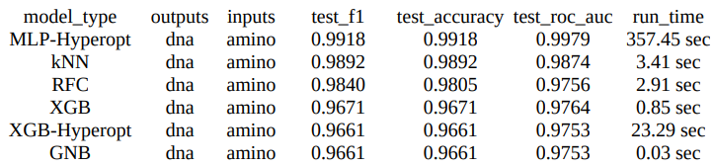
Study Results (amino)
Verified that codon frequencies can be used with modest cost

Slide 18
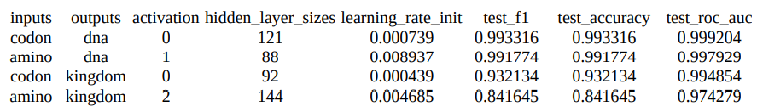
Conclusions
Replicated Khomtchouk 2020 study with similar results
Amino acid frequencies can be used effectively for prediction
Best model: MLP with hyperopt, k-NN close and cheap

Slide 19
Next Steps
More graphical EDA including SHAP heatmap plots
Explore correlations among aminos and codons
Resolve anomaly surrounding XGBoost with hyperopt
Include all performance metrics used in 2020 study
Fit models using untrimmed data for comparison
Determine ratio of codon to corresponding amino to fit models based on codon bias

